Slide 1
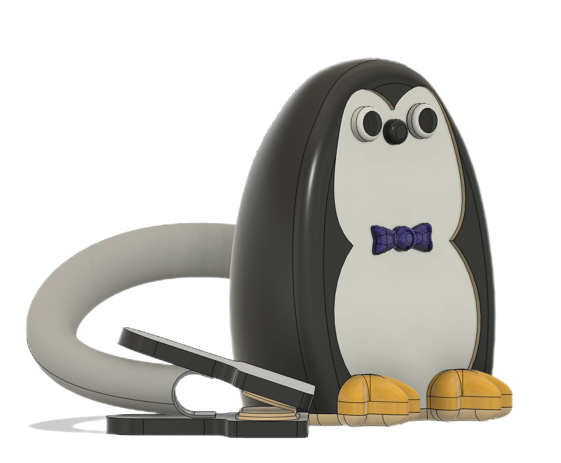
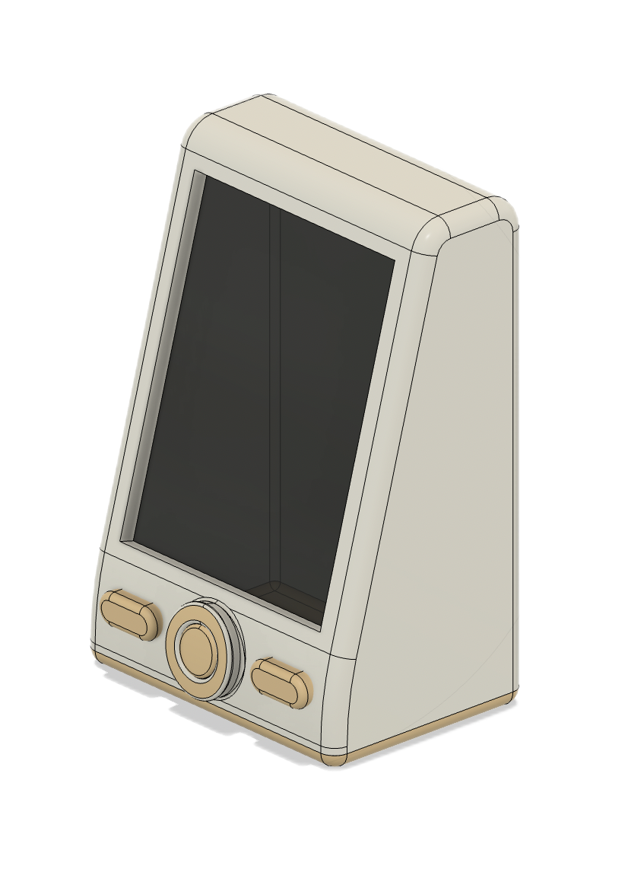
Baby Monitor
Newly Lanuched

Slide 2
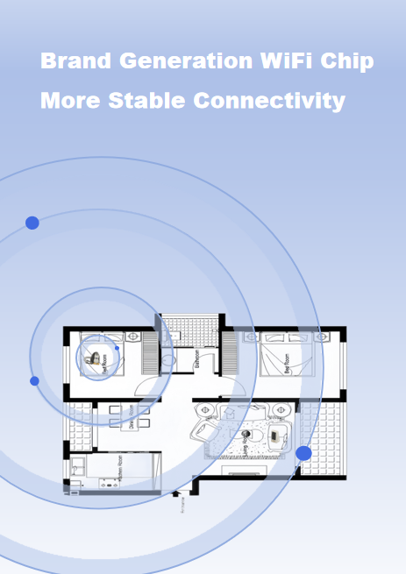
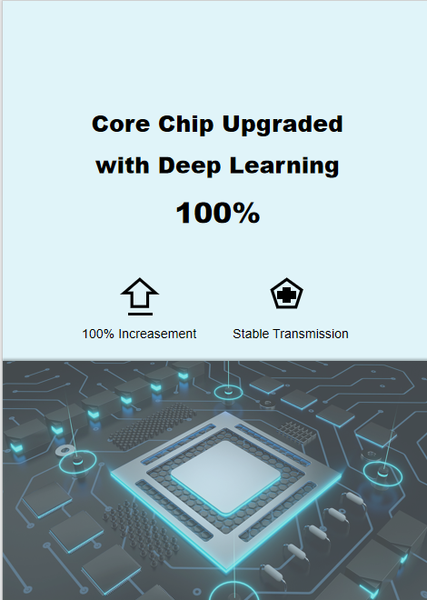
Professional Care Fully Upgraded
01 Performance Upgrade
02 Experience Upgrade

Slide 3
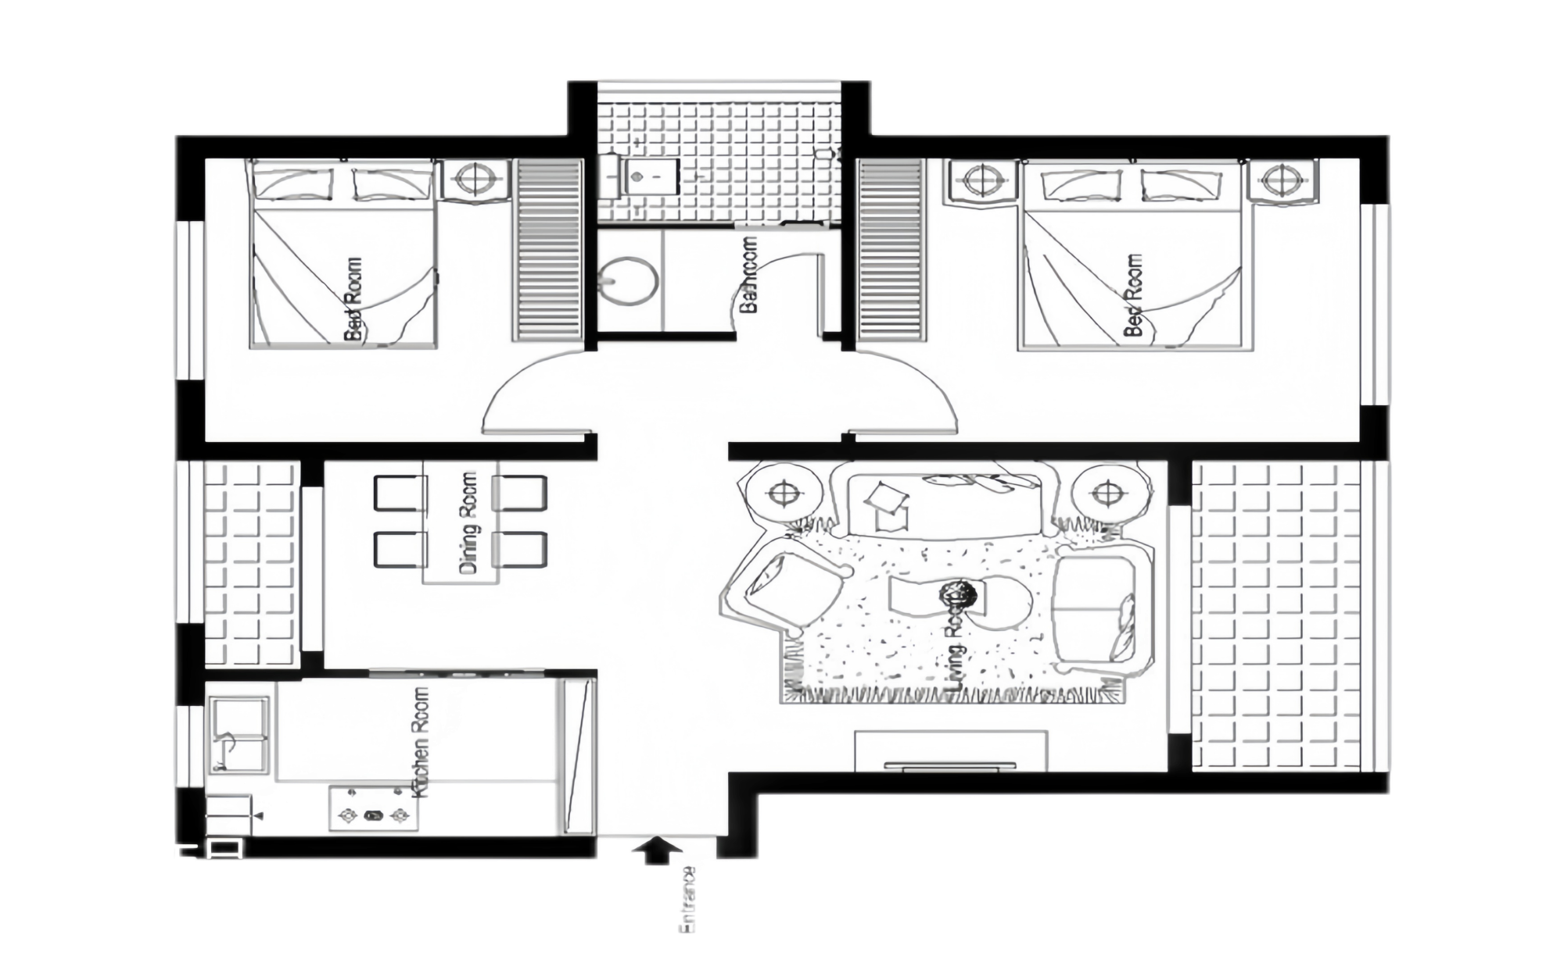
Point 01
Brand Generation WiFi Chip
More Stable Connectivity
Extended Transmission
Ideal for Multi-Room
Sensitive Through Wall

Slide 4
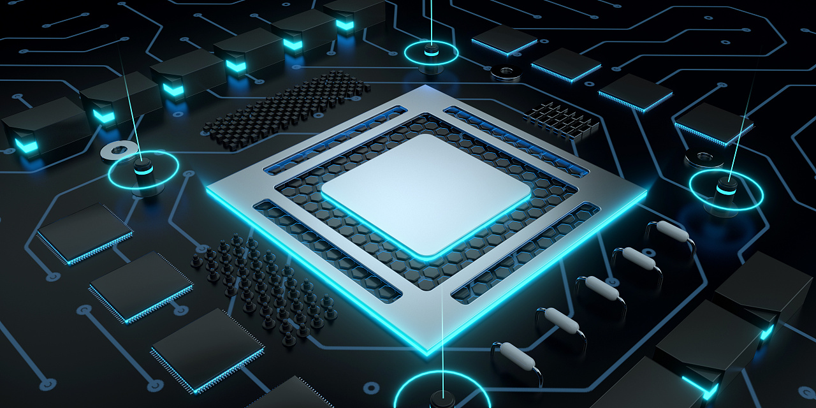
Point 02
Core Chip Upgraded
with Deep Learning
100% Increase in Computing Power, More Accurate Algorithms, Enhanced AI Monitoring Sensitivity
100% Increasement
Stable Transmission

Slide 5






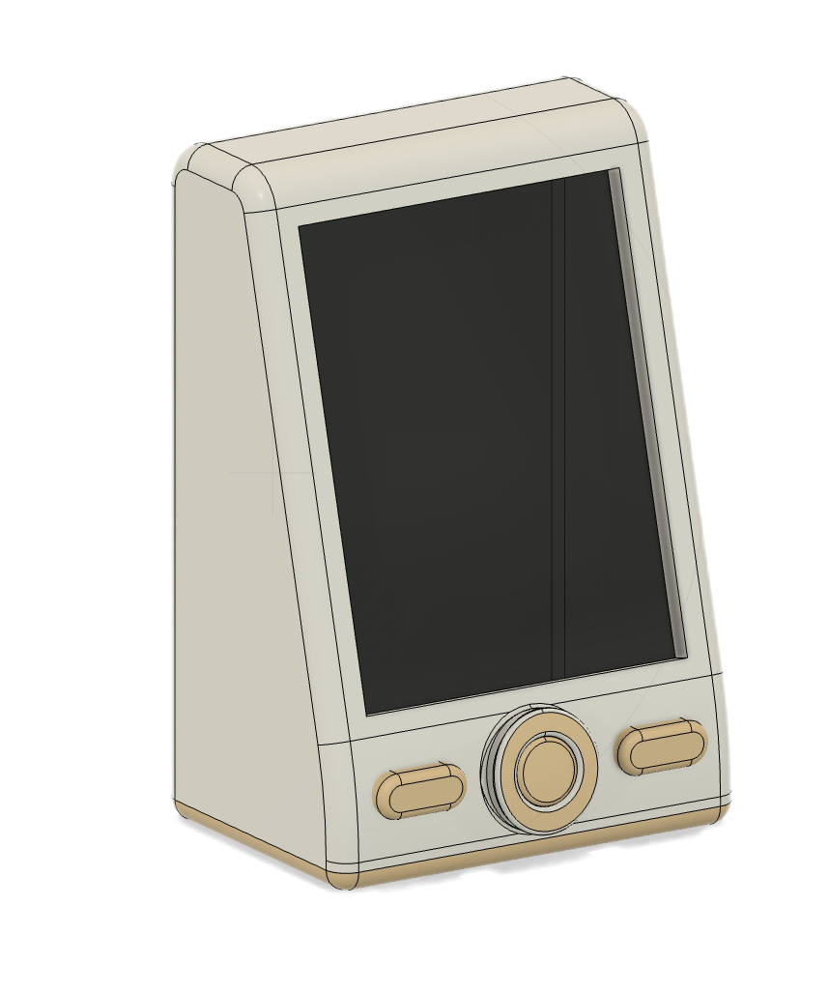
Scientific Parenting
Free from Anxiety
AI Mask Reminder
Cry Detection
Human Tracking
Temperature Monitor
Sleep Guard
Photo Album

Slide 6
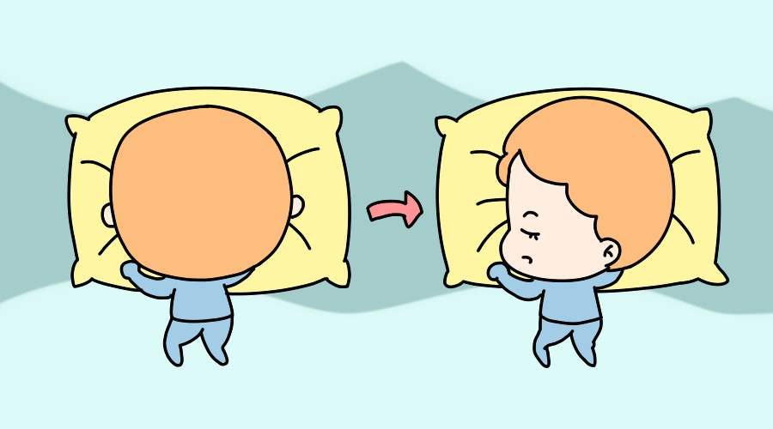
Point 03
All-day Vigilance
Baby's Sleep Guardian
Smart Detection of Baby's Risks
ie. Head Covering or Prone Sleeping
# Timely Alerts to Parents #

Slide 7
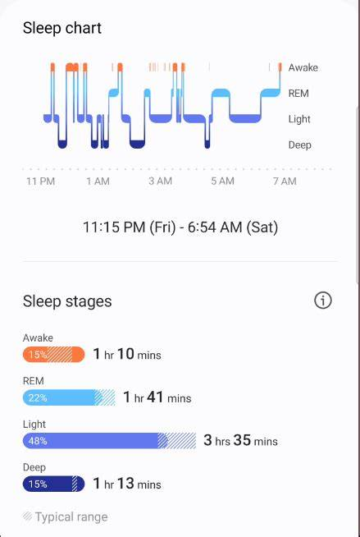
Point 04
Upgraded Sleep Analysis
New Breath Sensing Algorithm
Analyzing Baby's Deep/Surface Sleep Times
Assisting in Cultivating Healthy Sleep Habits

Slide 8
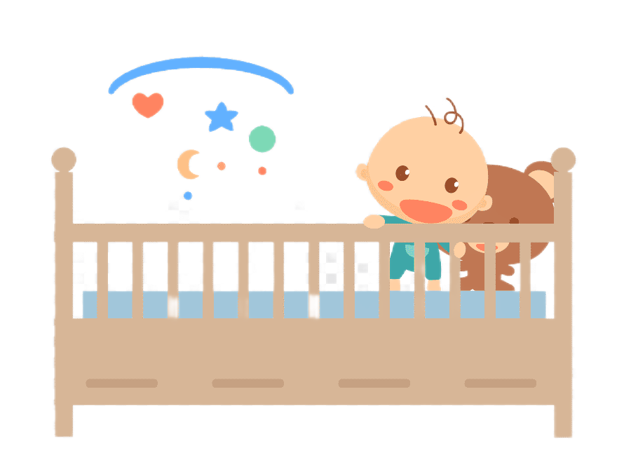
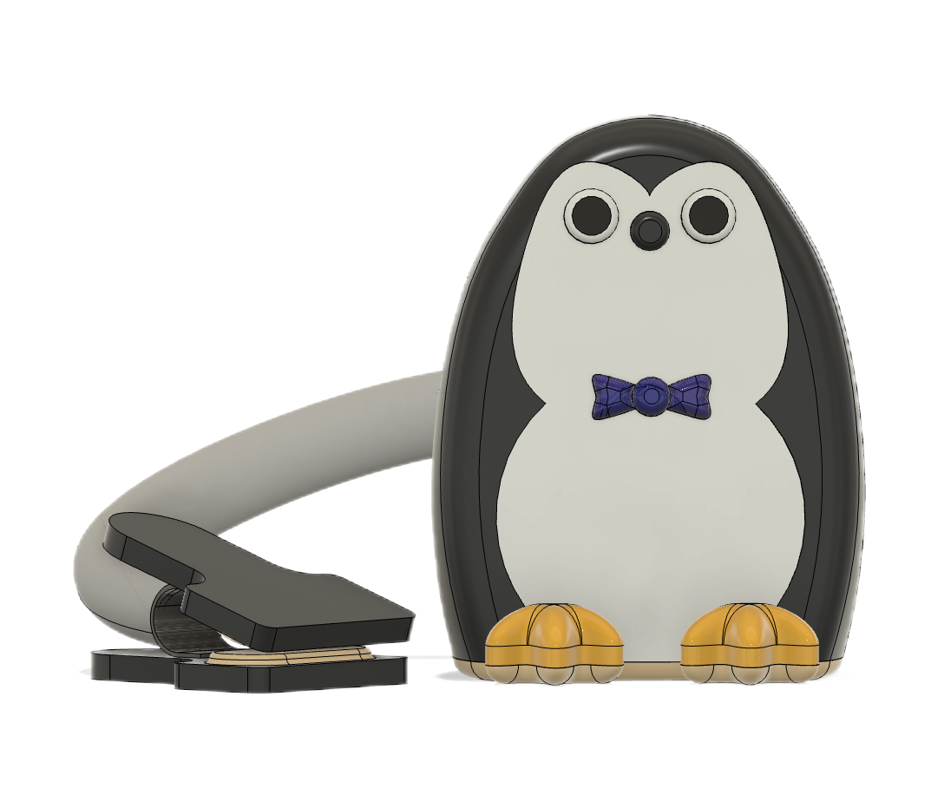
Point 05
Human Tracking
Automatically Adjusts Angle upon Human Detection
Multi-angle Comprehensive Monitoring
Keeps Up with Active Babies

Slide 9
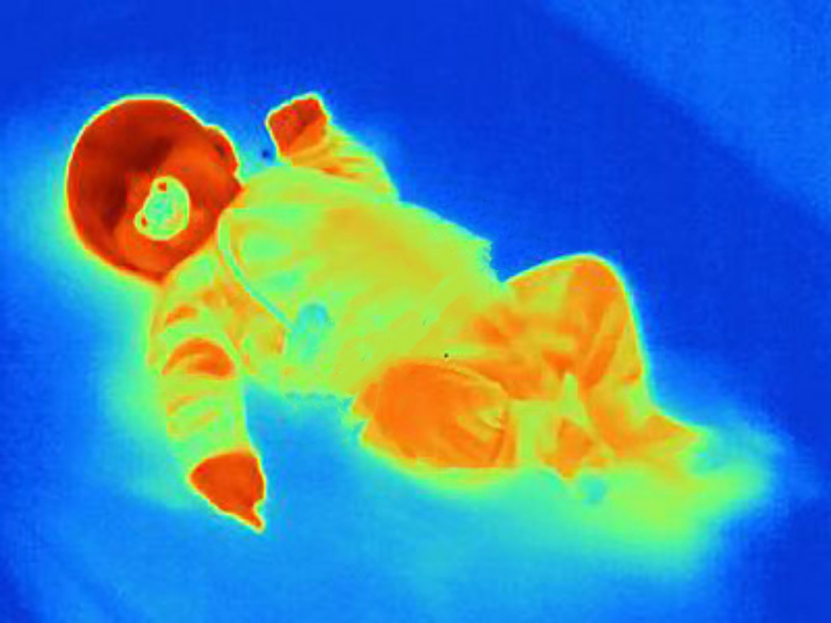
Point 06
Temperature Monitor
Thermal Imaging Temperature Measurement
Baby's Body Temperature
Room Temperature

Slide 10
Point 07
Memorable Moments Photo Album
Automatically Generate Highlight Reel Videos
Easily Share Your Baby's Growing Moments with One Click
Point 08
AI Smart Snapshot
Every Memorable Moment
Intelligent Recognition of Baby's Frontal Face and Varied Expressions Automatically Capturing Precious Moments of Growth

Slide 11


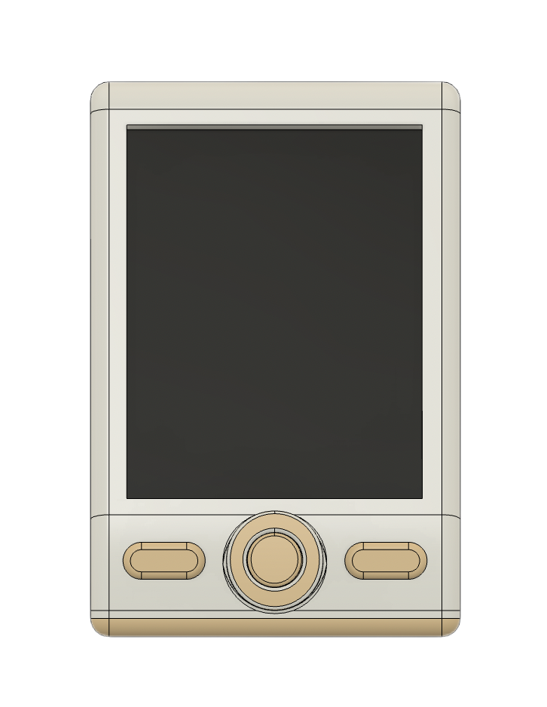
Point 09
Immediate Alert for Baby's Crying
Cry Detection
Real-Time Alerts Sent to Screen and Phone
The baby’s crying !!!
The baby’s crying !!!

Slide 12
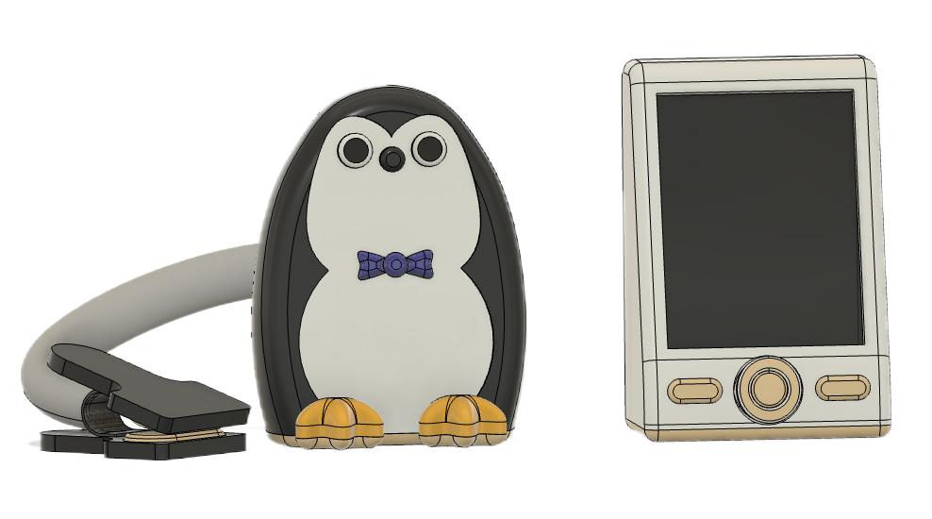
Point 10
Top Picks for New Parents
Product Name
Age Range
Compatible Systems
Camera
Product Dimensions
Power
Intelligent Baby Monitor
0-8 years
Above iOS13.0 / Android9.0
7.68 million pixels
14.38 cm×6 cm×8.3 cm (camera)
15 cm×7 cm×10 cm (monitor)
5V/2A

